Slide 1
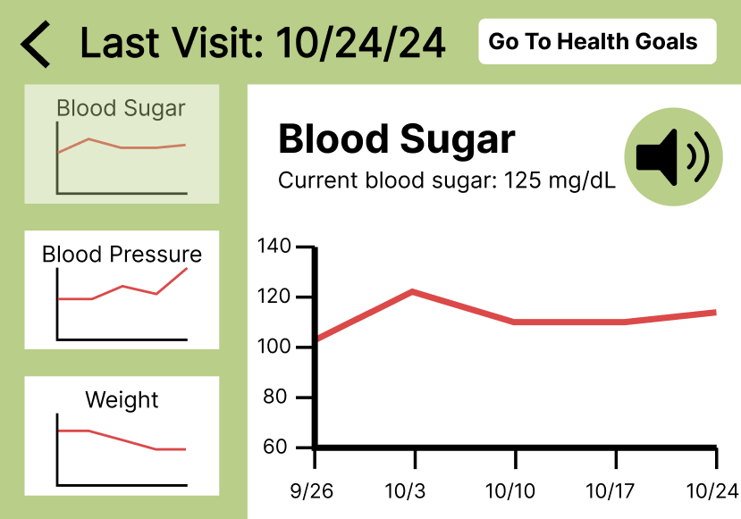
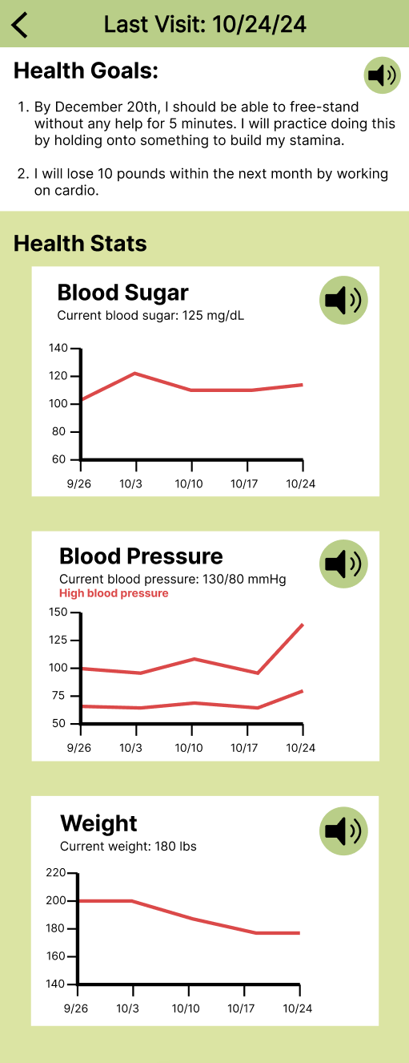
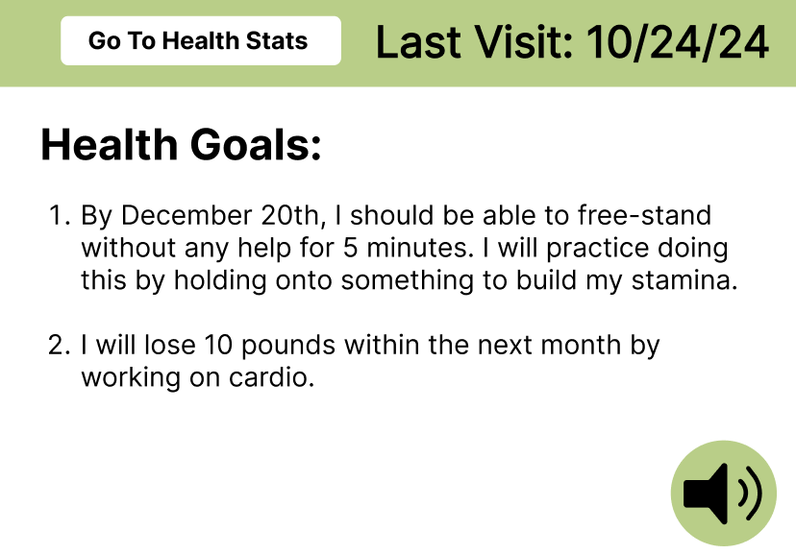
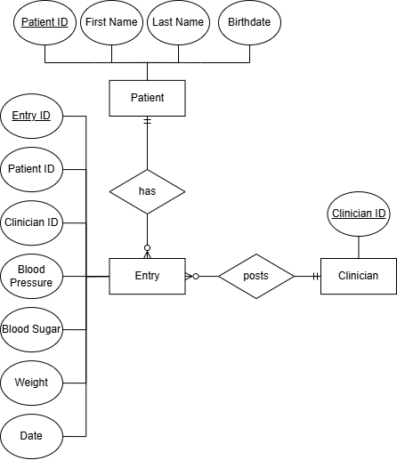
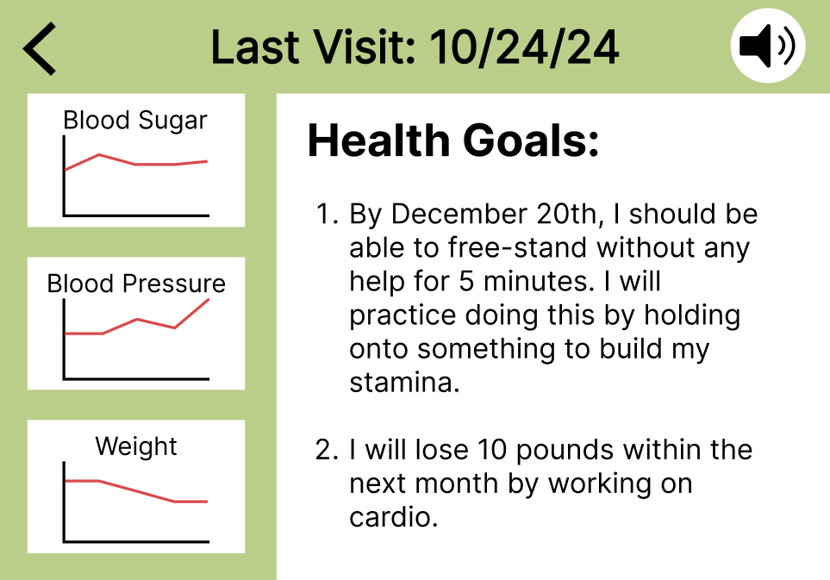
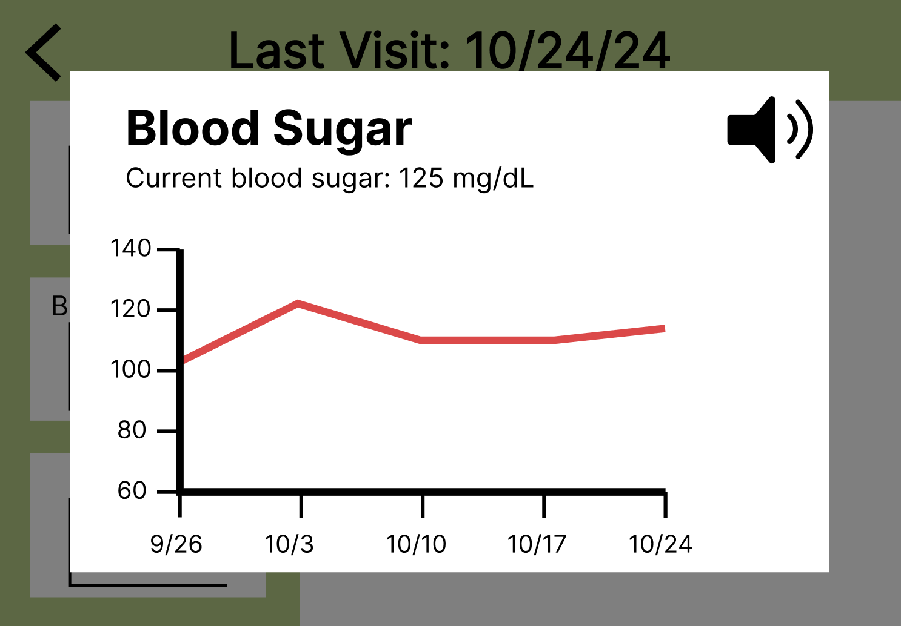

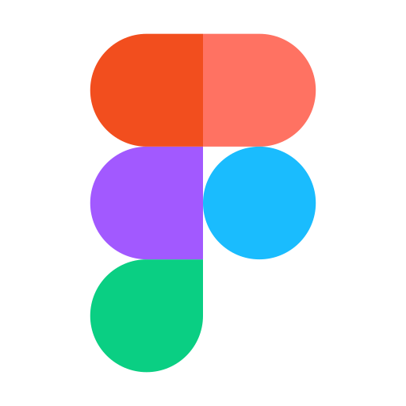


25-302
Mobile Health and Wellness Program - Patient Portal
Team members: Prakash Chatlani, Rachel Farzan, Isaiah Hill, Angela Tran | Faculty advisor: John Leonard | Sponsor: Jered Wendte
Problem
Figma Prototypes
Approach
The Mobile Health and Wellness Program (MHWP) run by VCU’s School of Nursing sets up wellness clinics in nine Richmond community spots, providing health check-ups, monitoring, and coaching. Right now, a big issue is that patients don’t have a simple way to look back at their past visits or get ready for upcoming ones. While both patients and clinicians fill out surveys during appointments, there’s no easy way for patients to review that information.
Program Overview: MHWP offers wellness clinics in nine community locations across Richmond.
Services Provided: Health assessments, monitoring, and coaching.
Current Gap: Lack of a user-friendly way for patients to view past visits and prepare for future ones.
Data Usage: Patients and clinicians complete surveys during appointments, but there's no accessible summary for patients.
Version 1: Health stats and health goals on different pages, click on graphs to see close up.
Version 3: Health stats and health goals on the same scrollable page page.
Research: Our team analyzed similar mobile health applications, identified design elements that cater specifically to our target demographic, and interviewed patients for desired features.
Prototype: Our next step was to create a series of Figma prototypes, pictured to the left. We will continue to evaluate with the patients to decide on the best, most intuitive design.
Database: We decided to use MySQL for our database to store all the information about our patients and clinicians.
Application: Our final application will utilize React Native, a flexible tool that works with Expo to allow us to view our application on our devices.
Relational Database -- MySQL
Version 2: Health stats and health goals on the same page, click on graphs to see close up.
Objectives
Create a user-friendly health app that helps older adults prepare for check-ups by making health data—such as blood sugar, blood pressure, weight, and health goals—easily accessible.
Include features for improved legibility, support for limited dexterity, and options for printing health information to accommodate varying needs.
Enhance health literacy and empower elderly users to make informed decisions about their well-being.
Other Features:
Patient lookup using name and birthday
Patient home screen
To be used by clinician
Settings screen
Text size adjustment
Color modes
Print PDF button

